Slide 1
Conditional Access

Slide 2
Topics
  What is CAS?
  Three basic elements of CAS
  Terminologies in CAS
  Basic Scrambling System
  Return Path and its advantages/disadvantages
  PVR Overview and its Features

Slide 3
What is Conditional Access System?
    A Conditional Access System (CAS) has two goals:
    1) Enable legitimate subscribers access to view content
    2) Prevent unauthorized viewers from accessing content
    Conditional Access Systems work by scrambling the video signal using a set of secret keys. Those secret keys are protected using encryption.
    Conditional Access Systems are used in Satellite, Cable, Terrestrial and DSL television distribution networks.
Notes:
Digital subscriber line

Slide 4
Conditional Access Process
A typical CA process involves three basic elements:
    The broadcast equipment :
      The broadcast equipment generates the encrypted programs that
      are transmitted to the subscriber.
    The set-top box
      When these are transmitted, the set-top box filters out the signals
      and passes them to the security module.
    The security module [Smart Card]
      The security module then authorizes these programs for decryption,
      the programs are then decrypted in real time and sent back to the
      set-top box for display.

Slide 5
Terminologies in CAS
Access Control System/Conditional Access System:
  The complete system for ensuring that broadcasting services are
  only accessible to those who are entitled to receive them.
  The system usually consists of three main parts –
  signal scrambling
  encryption of the electronic “keys” needed by the viewer
  Subscriber management system which ensures that viewers entitled to Watch
Conditional Access Sub-System (CASS):
  The part of the decoder which is concerned with decoding the electronic
  keys, and recovering the information needed to control the
  descrambling sequence.
  It is now usually implemented, all or in part, as a smart card.
Scrambling:
The method of continually changing the form of the broadcast signal so that, without a suitable decoder and electronic key, the signal is unintelligible.
[Data stream is scrambled with an 8-byte secret key]
Descrambling:
  The process of undoing the scrambling to yield intelligible pictures, sound and/or data services

Slide 6
Terminologies in CAS
Control Word:
    The key used in the descrambler.
Electronic key:
  A general term for the data signals used to control the descrambling process in the decoders.
  There are several different levels of key, identifying the network which
  the subscriber is entitled to access,
  The services within that network that are available to the subscriber and the detailed control information to operate the descrambler.
Entitlement Control Message (ECM):
  A cryptogram of the control word and the access conditions. An ECM is a
  specific component of the electronic key signal and over-the-air addressing information. The ECMs are used to control the descrambler and are transmitted over-air in encrypted form.
Entitlement Management Message (EMM):
  A message authorizing a viewer to descramble a service. An EMM is a
  specific component of the electronic key signal and over-the-air addressing information. The EMMs are used to switch individual decoders, or groups of decoders, on or off and are transmitted over-air in encrypted form.

Slide 7
Terminologies in CAS
Subscriber Authorization System (SAS):
The centre responsible for organizing, sequencing and delivering EMM
and ECM data streams under direction from the Subscriber Management System.
Subscriber Management System (SMS):
The business centre which issues the smart cards, sends out bills and receives payments from subscribers. An important resource of the Subscriber Management System is a database of information about the subscribers, the serial numbers of the decoders and information about the services to which they have subscribed.
Smart Card:
A device that looks rather like a credit card; it is used as a token of entitlement to descramble broadcast signals. Most of the major European access control systems
use smart cards. Other systems that bury the same functionality inside the decoder do not usually allow the system to be changed to combat piracy or to add new
services. Smart cards can be issued by the Subscriber Management System which can validate them by pre-programming them with keys to authorize access to
certain tiers of programmes and/or data services. As part of the same issuing and validation process, the card may be personalized to make each one valid for one particular decoder only.

Slide 8
Terminologies in CAS
Impulse Pay-Per-View:
Impulse Pay-Per-View requires no pre-booking. This rules out some Pay-Per-View methods (e.g. issuing smart cards for specific programmes). Smart card debit, or electronic banking via telephone line, both support impulse Pay-Per-View. Over-the-air addressing can support impulse PPV, provided that the time taken to process
the request is sufficiently small (this implies a relatively large capacity for over-the-air addressing data in the transmission channel.
Pay-Per-View (PPV):
A payment system whereby the viewer can pay for individual programmes rather than take out a period subscription. Pay-Per-View can work by debiting electronic credit stored in a smart card, by purchasing smart cards issued for special programmes, or by electronic banking using a telephone line to carry debiting information from the home to the bank
Period Subscription:
The most popular payment system, in which the viewer subscribes to a programmes service for a calendar period (e.g. one year).
Multiplex:
An assembly of all the digital data that is carrying one or more services within a single physical channel

Slide 9
Terminologies in CAS
Piracy: Unauthorized access to controlled programmes.
Common methods of piracy include the issue of counterfeit smart cards and decoders which bypass all or part of the access control system. The use of video cassette recorders to record descrambled pictures for distribution among
friends/colleagues is also a simple method of piracy.

Slide 10
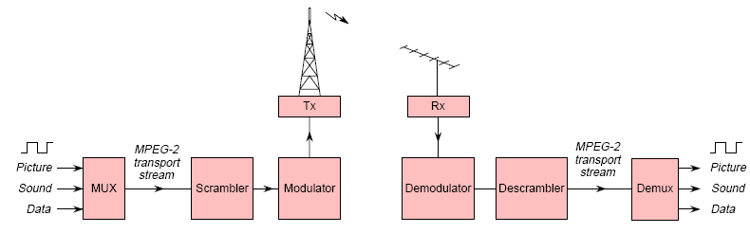
Basic scrambling system

Slide 11
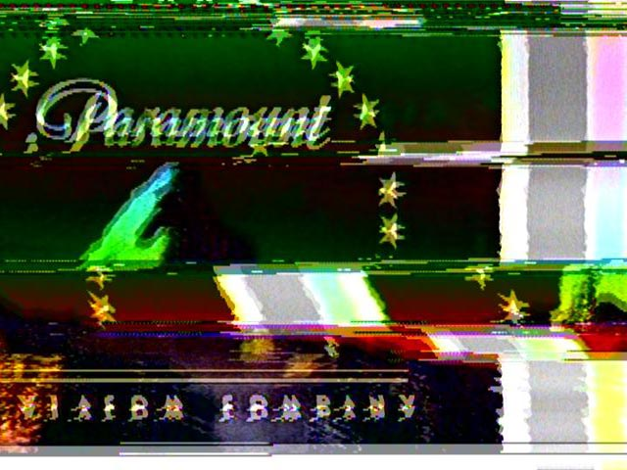
Scrambled cable channel
A scrambled cable channel as viewed without a decoder

Slide 12
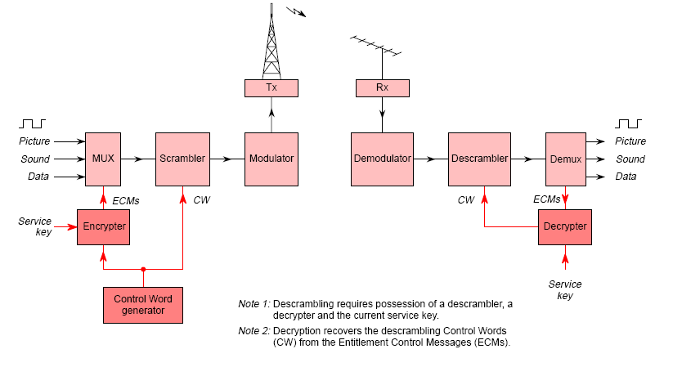
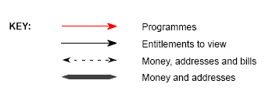
Scrambling with Encrypted Control Words.

Slide 13
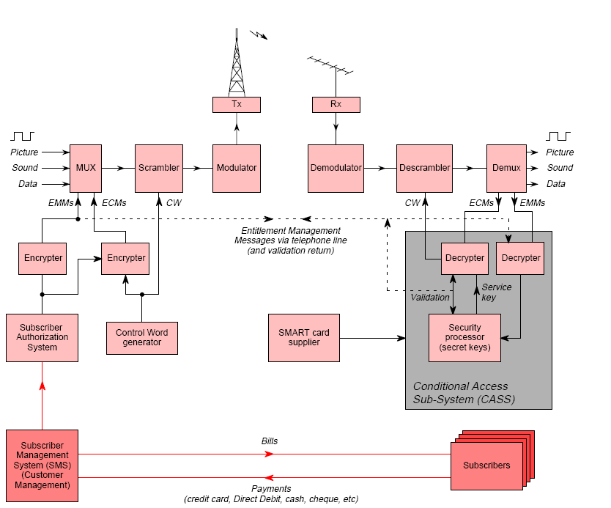
Scrambling system with encrypted CW,EMM & SMS

Slide 14
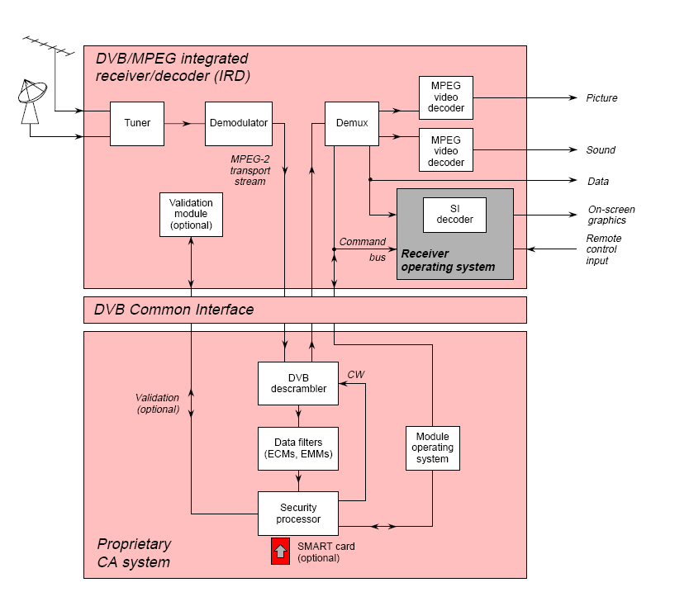
DVB/MPEG Integrated Receiver/Decoder (IRD)

Slide 15


